Slide 1
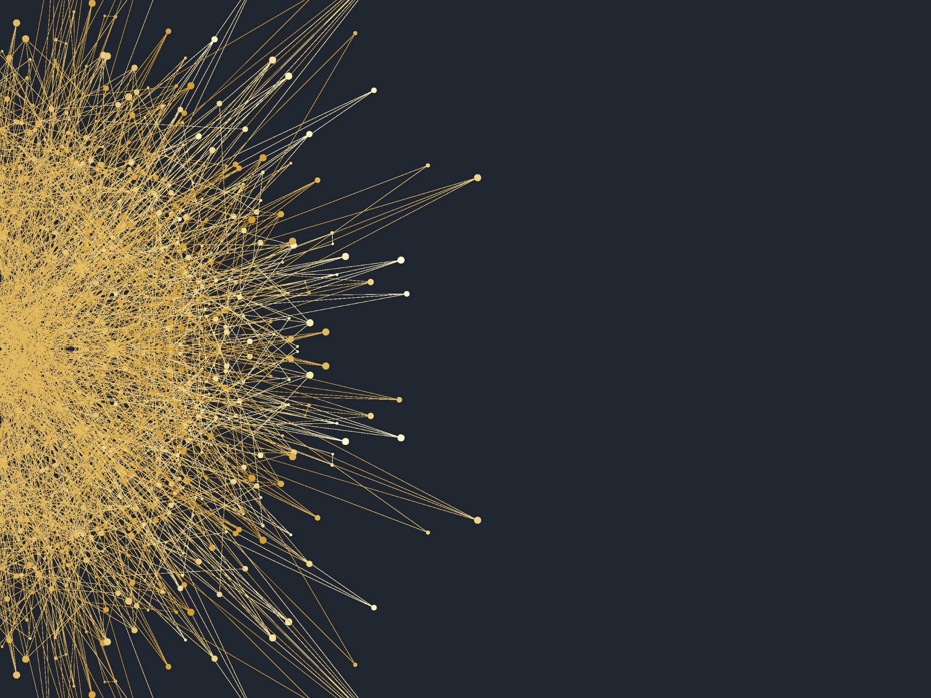
Deep Learning for NLP Lecture 3: More Word Vectors
2018.01.17
AILab

Slide 2
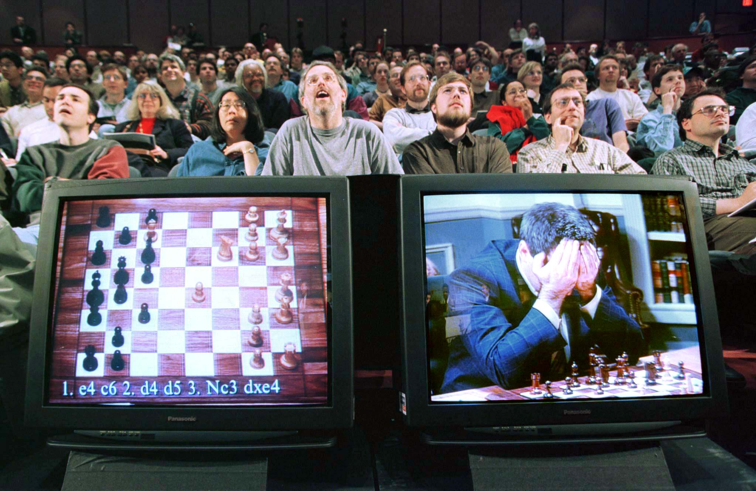
IBM 딥블루가 체스 세계 챔피온 가리 카스파로프를 이기다.

Slide 3
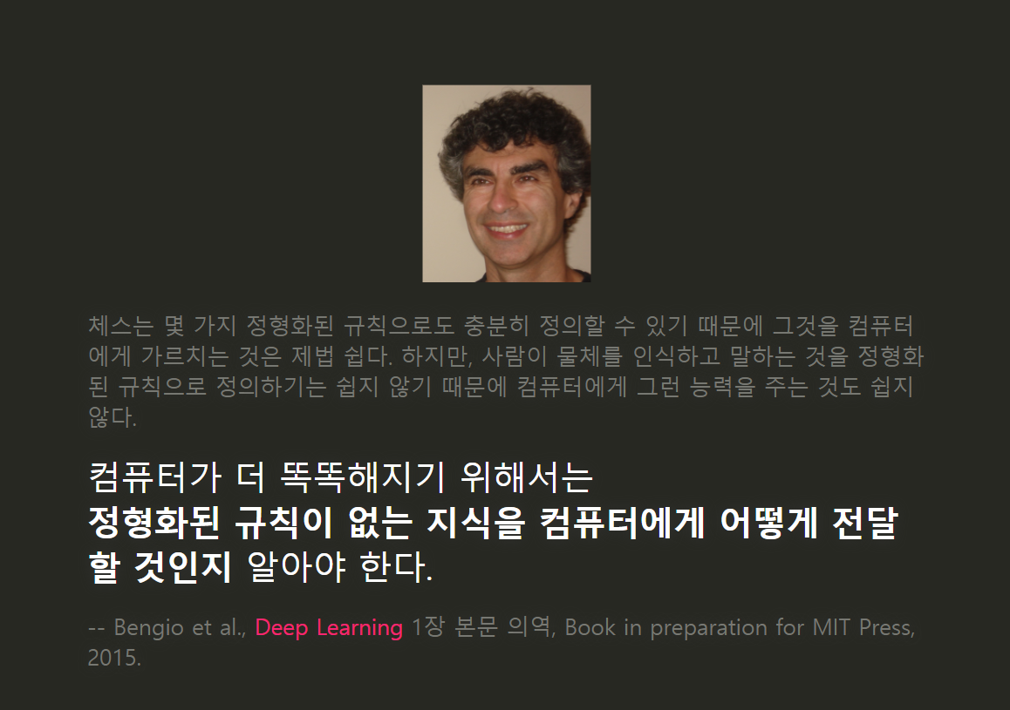

Slide 4
텍스트를 "표현"하는 다양한 방법
Representations of text

Slide 5
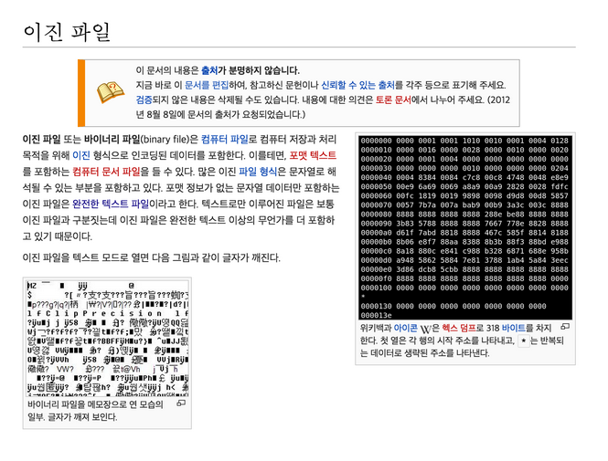
어떻게 하면 구조가 없는 데이터인 텍스트의 의미를 컴퓨터가 잘 이해할 수 있을까?
좌측은 사람이 읽는 텍스트, 우측은 컴퓨터가 읽는 바이너리. 하지만 바이너리에는 "의미 정보"가 담겨있지 않다.

Slide 6
텍스트의 의미를 이해한다 ≈ 유사한 의미를 가진 텍스트끼리 묶을 수 있다
{단어, 문서} ⊂⊂ 텍스트

Slide 7
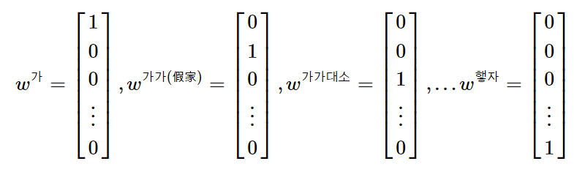
먼저, 단어를 표현하는 가장 쉬운 방법은, 이진(binary) 표현법
w^{i} 은 i번 단어에 대한 벡터 표현
각 벡터의 크기는 모든 단어의 set인 전체 사전의 크기 |V||V| 와 같다
뉴럴넷 쪽 학자들은 이렇게 표현한 벡터를 보통 one-hot vector라고 한다
어떤 사람들은 이런 방식의 인코딩을 1-of-V 코딩이라고도 한다

Slide 8
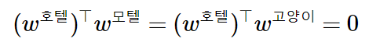
하지만 이진 표현법을 사용하면 단어 간 유사도를 정의할 수 없다.
ex: "호텔"과 "모텔", "호텔"과 "고양이" 사이의 거리가 전부 0으로 같다.

Slide 9
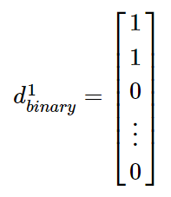
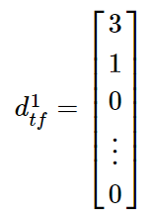
같은 철학으로 문서를 표현한 것이, bag of words(BOW)
단어가 문서에 존재한다/안한다 (term existance)
단어가 문서에 n번 존재한다 (a.k.a. term frequency (TF))
단어에 중요도를 할당하고 문서에 등장한 단어 중요도의 가중합을 구한다
ex: term frequency–inverse document frequency (TF-IDF)

Slide 10
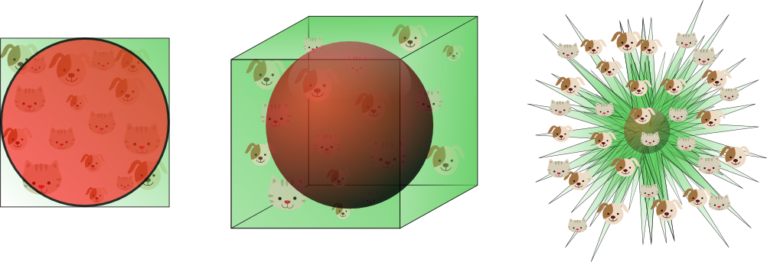
그런데 공간의 차원이 너무 커서 문서 간 유사도 지표의 효과가 떨어진다.
공간의 차원이 커질수록 데이터의 대부분은 공간의 꼭지에 분포하게 된다.
문서 간 거리의 편차가 매우 적어지게 됨
문서 간 유사도가 "또이또이"

Slide 11
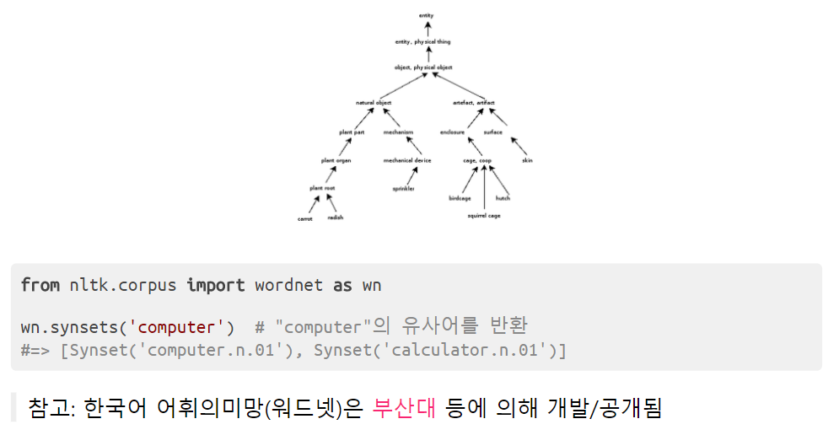
"그럼 워드넷 같은 텍소노미를 활용하는건 어때요?"
워드넷(WordNet)은 X is-a Y와 같은 상위어(hypernym) 관계 등을 정의하는 방향성 비순환 그래프(DAG; directed acyclic graph)입니다. (예: 사과는 과일이다.)

Slide 12
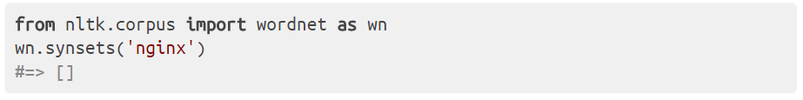
하지만 워드넷은 다음의 단점이 있습니다:
모든 용어를 포함하려고는 하지만, 전문 도메인 용어들은 많이 빠져있다.
각종 신조어에 대한 정보를 확보하기 위해서는 꾸준히 유지보수를 해줘야 한다.
게다가 NLTK로는 한국어 지원이 안됨... (중요!)

Slide 13
아.. 안되겠다. 다른 방법 없나?

Slide 14
친구를 보면 그 사람을 안다.
類類相從

Slide 15
친구를 보면 그 사람을 안다.
類類相從

Slide 16
단어의 주변을 보면 그 단어를 안다.
You shall know a word by the company it keeps.
-- 언어학자 J.R. Firth (1957)

Slide 17
예시 1: 빈 칸 안에 맞는 말?
새로운 디자인의 선이 __ 하다.
야, 부엌 좀 __ 히 하자.
깜박하고 책상 위를 __ 하게 치우지 않았다.

Slide 18
예시 2: "매나니"라는 단어를 아시나요?
なに?

Slide 19
그 녀석 무슨 배짱인지 매나니로 와서 일을 하겠다고 한다.
삽이라도 있어야 땅을 파지 매나니로야 어떻게 하겠나?
SO만 있으면 코딩은 매나니로도 할 수 있다고 한다.

Slide 20
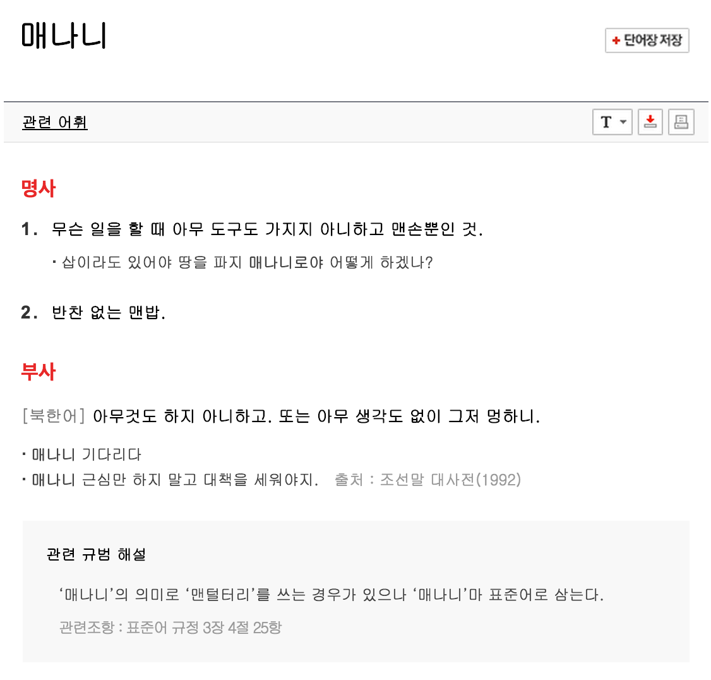
실존하는 단어;;

Slide 21
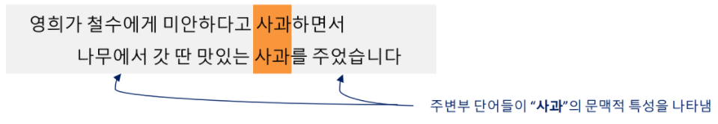
다시 말해, 단어의 의미는 해당 단어의 문맥(context)이 담고 있다.
문맥(context) := 정해진 구간(window) 또는 문장/문서 내의 단어들
보통 영어의 구간은 좌우 1-8개 단어, 총 3-17개 단어의 문맥을 본다
두 단어의 문맥이 비슷하면 "의미적"으로 유사한 단어
ex: "PyCon"은 "R"보다 "Python"에 가깝다?

Slide 22
"Co-occurrence"
두 단어가 정해진 구간 내에서 동시에 등장함

Slide 23
Co-occurrence를 정의하는 두 가지 방법
documents = [["나는", "파이썬", "이", "좋다"],
["나는", "R", "이", "좋다"]]
Term-document matrix (Xtd∈R|V|×MXtd∈R|V|×M): 한 문서에 같이 등장하면 비슷한 단어
Computation이 문서의 개수 MM에 비례(!)
Term-term matrix (Xtt∈R|V|×|V|Xtt∈R|V|×|V|): 단어가 문맥 내에 같이 존재하면 비슷한 단어
문맥의 길이가 짧을수록 syntactic, 길수록 semantic 정보를 포함
앞뒤로 단어를 두 개씩 보는 경우 (문맥의 길이==5):
x_td = [[1, 1], # 나는
[1, 0], # 파이썬
[0, 1], # R
[1, 1], # 이
[1, 1]] # 좋다
x_tt = [[0, 1, 1, 2, 0], # 나는
[1, 0, 0, 1, 1], # 파이썬
[1, 0, 0, 1, 1], # R
[2, 1, 1, 0, 2], # 이
[0, 1, 1, 2, 0], # 좋다

Slide 24
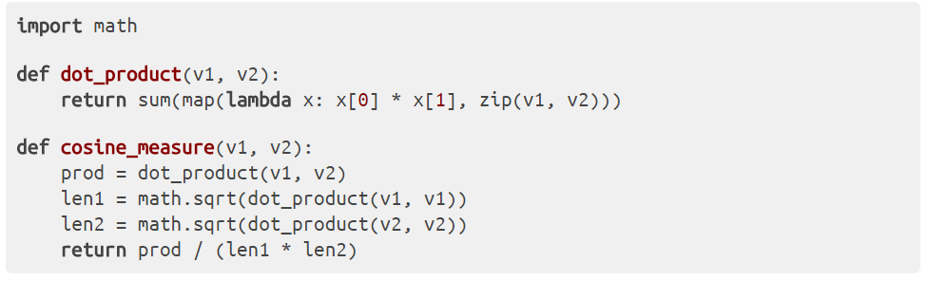
Co-occurrence matrix를 있는 그대로 이용해도 단어 간 유사도를 구할 수는 있다.
하지만:
값들이 너무 skewed 되어 있고 (즉, 빈도 높은 단어와 낮은 단어의 격차가 큼)
정보성 낮은 단어 때문에 discriminative하지 않음 (ex: list('은는이가'))
유사도 정보가 담긴 단어 벡터를 구하는 더 나은 방법은?

Slide 25
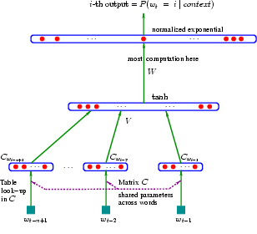
Neural embeddings
아이디어: 문맥에 있는 단어를 예측하라!
언어 모델(language model) 활용
ex: ["나는", "파이썬", "이", "좋다"] 다음에 뭐가 나올까? (ex: "!", ".""?")
그리고, 학습할 때 뉴럴넷을 쓰자.
Neural network language model (NNLM)

Slide 26
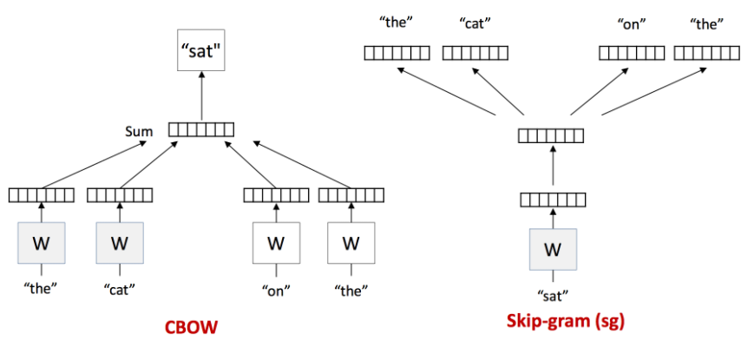
word2vec
요즘 핫한 T. Mikolov의 word2vec도 neural embedding
각종 계산 트릭을 적용해서 컴퓨테이션이 빨라짐! (n일 -> m시간)

Slide 27
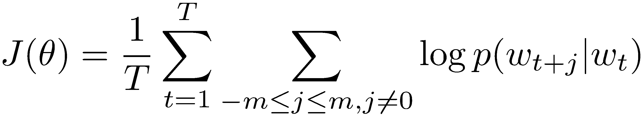
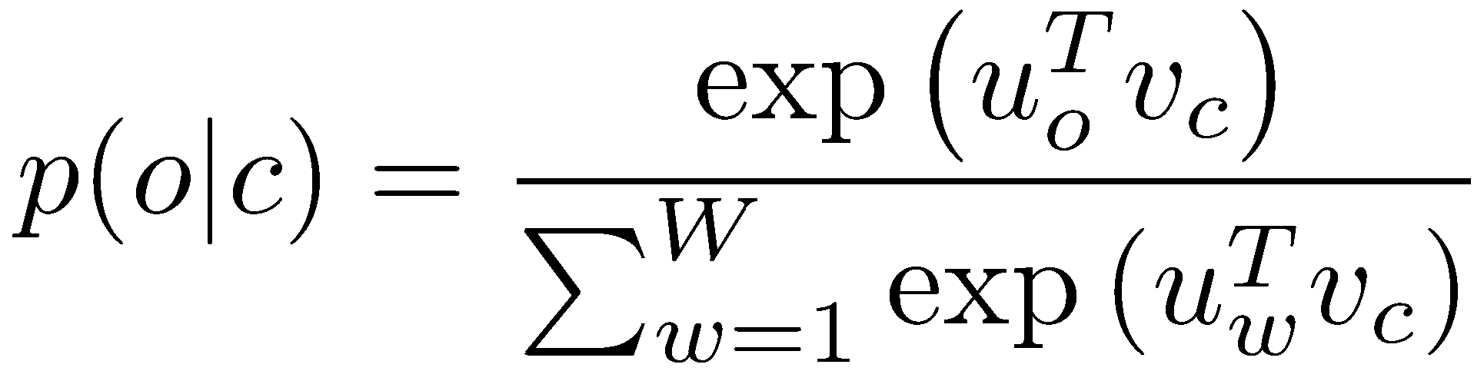
Refresher: The simple word2vec model
Main cost function J:
With probabilities defined as:
We derived the gradient for the internal vectors v_{c}

Slide 28
Calculating all gradients!
We went through gradients for each center vector v in a window
We also need gradients for outside vectors u
Derive at home!
Generally in each window we will compute updates for all parameters that are being used in that window.
For example window size c = 1, sentence:
“I like learning .”
First window computes gradients for:
internal vector v_{like} and external vectors u_{I} and u_{learning}
Next window in that sentence?

Slide 29
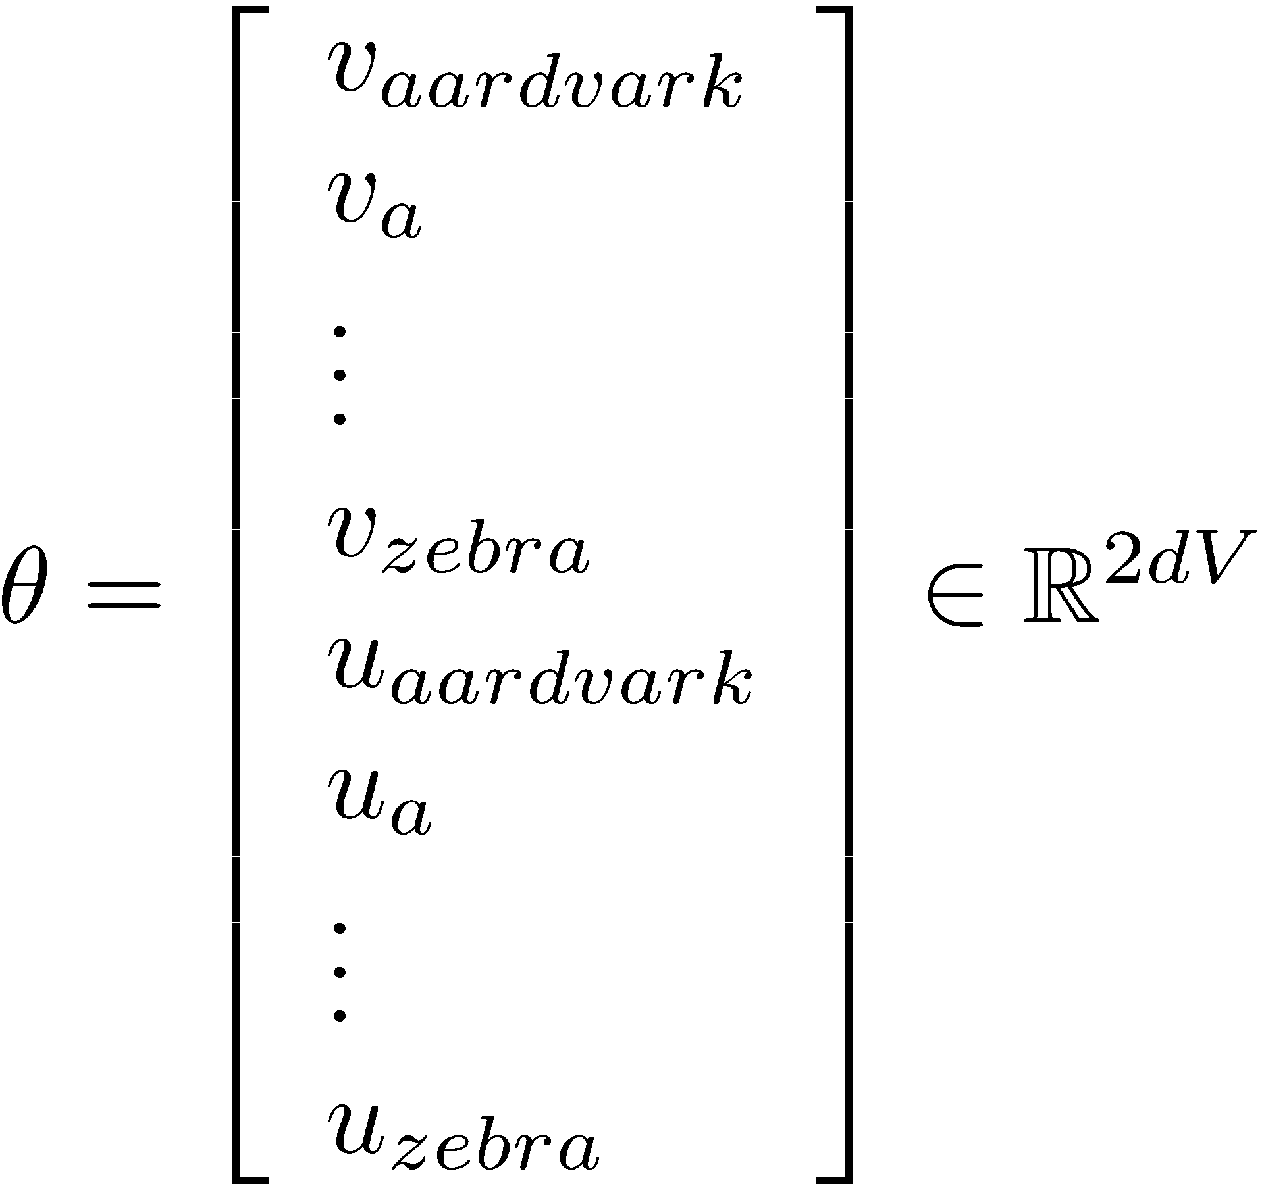
Compute all vector gradients!
We often define the set of ALL parameters in a model in terms of one long vector θ
In our case with d-dimensional vectors and V many words:

Slide 30
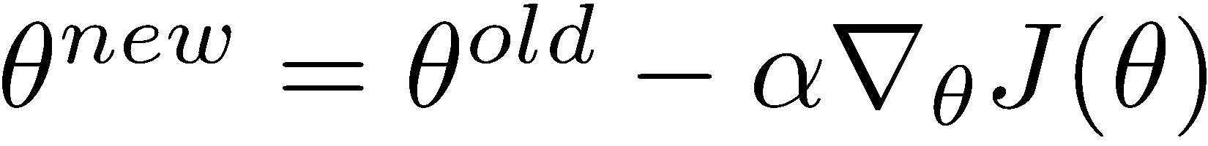
Gradient Descent
To minimize J(θ) over the full batch (the entire training data) would require us to compute gradients for all windows
Updates would be for each element of μ :
With step size ®
In matrix notation for all parameters:

Slide 31
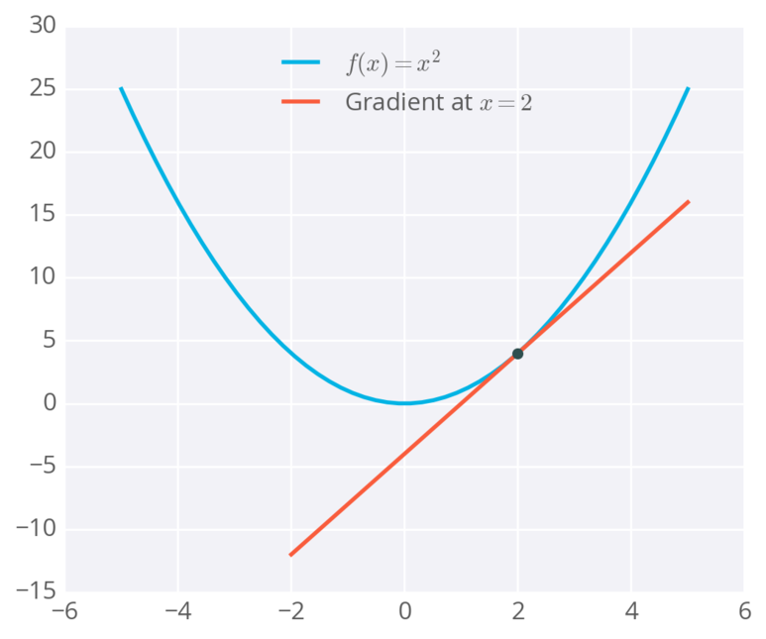
Gradient Descent

Slide 32
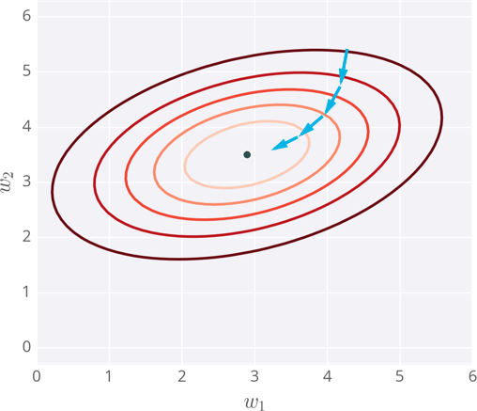
Gradient Descent

Slide 33
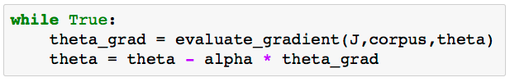
Vanilla Gradient Descent Code

Slide 34
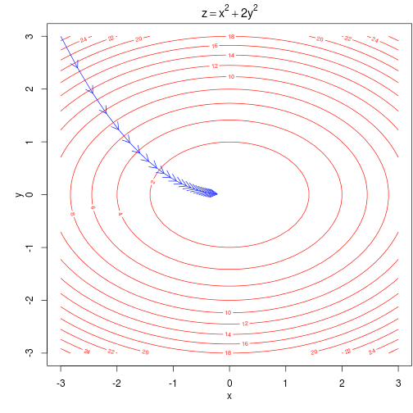
Intuition
For a simple convex function over two parameters.
Contour lines show levels of objective function

Slide 35
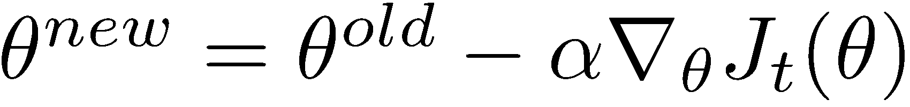
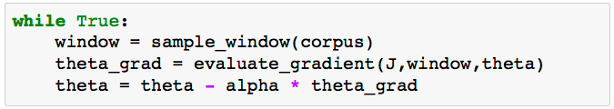
Stochastic Gradient Descent
But Corpus may have 40B tokens and windows
You would wait a very long time before making a single update!
Very bad idea for pretty much all neural nets!
Instead: We will update parameters after each window t
→ Stochastic gradient descent (SGD)

Slide 36
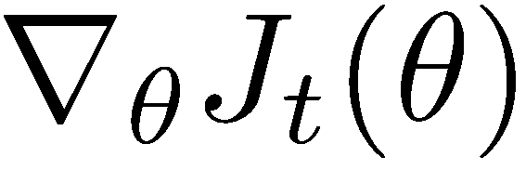
Stochastic Gradient Descent
But in each window, we only have at most 2c -1 words, so is very sparse!

Slide 37
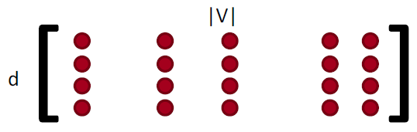
Stochastic Gradient Descent
We may as well only update the word vectors that actually appear!
Solution: either keep around hash for word vectors or only update certain columns of full embedding matrix U and V
Important if you have millions of word vectors and do distributed computing to not have to send gigantic updates around.

Slide 38
Approximations: PSet 1
The normalization factor is too computationally expensive
Hence, in PSet1 you will implement the skip-gram model
Main idea: train binary logistic regressions for a true pair (center word and word in its context window) and a couple of random pairs (the center word with a random word)

Slide 39
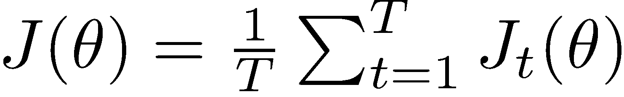
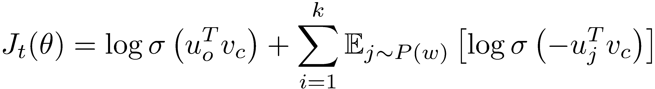
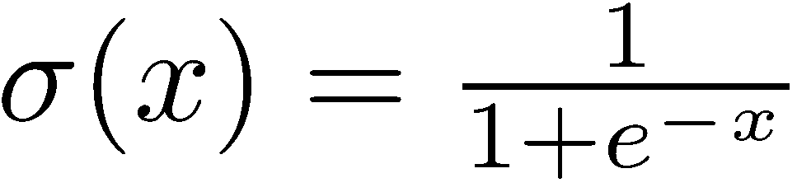
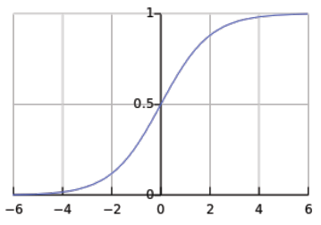
PSet 1: The skip-gram model and negative sampling
From paper: “Distributed Representations of Words and Phrases and their Compositionality” (Mikolov et al. 2013)
Overall objective function:
Where k is the number of negative samples and we use,
The sigmoid function! (we’ll become good friends soon)
So we maximize the probability of two words co-occurring in first log

Slide 40
PSet 1: The skip-gram model and negative sampling
Slightly clearer notation:
Max. probability that real outside word appears, minimize prob. that random words appear around center word
P(w)=U(w)^{3/4}/Z, the unigram distribution U(w) raised to the 3/4rd power (We provide this function in the starter code).
The power makes less frequent words be sampled more often

Slide 41
PSet 1: The continuous bag of words model
Main idea for continuous bag of words (CBOW): Predict center word from sum of surrounding word vectors instead of predicting surrounding single words from center word as in skipgram model
To make PSet slightly easier:
The implementation for the CBOW model is not required and for bonus points!

Slide 42
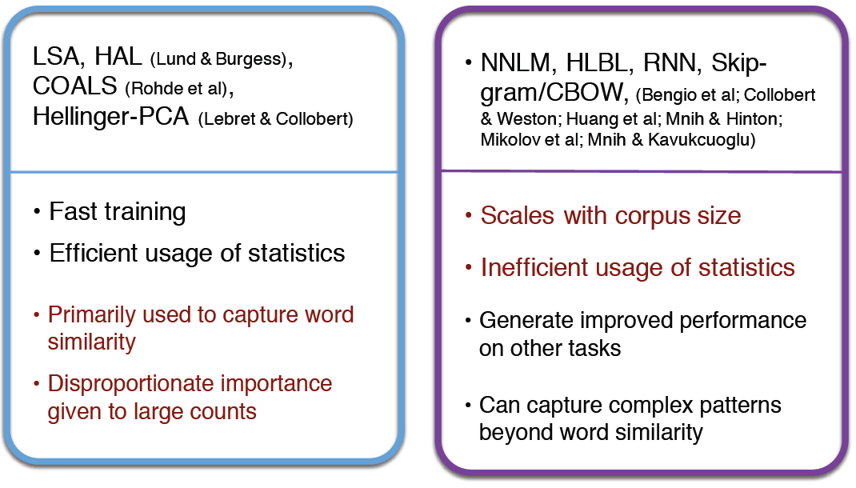
Count based vs direct prediction

Slide 43
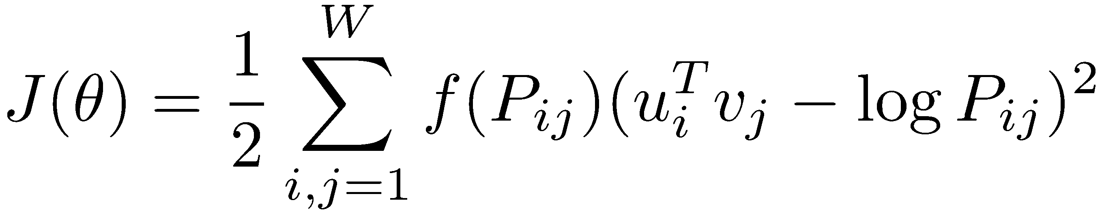
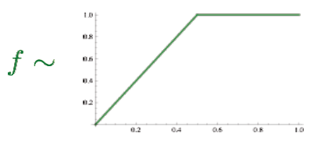
Combining the best of both worlds: GloVe
Fast training
Scalable to huge corpora
Good performance even with small corpus, and small vectors

Slide 44
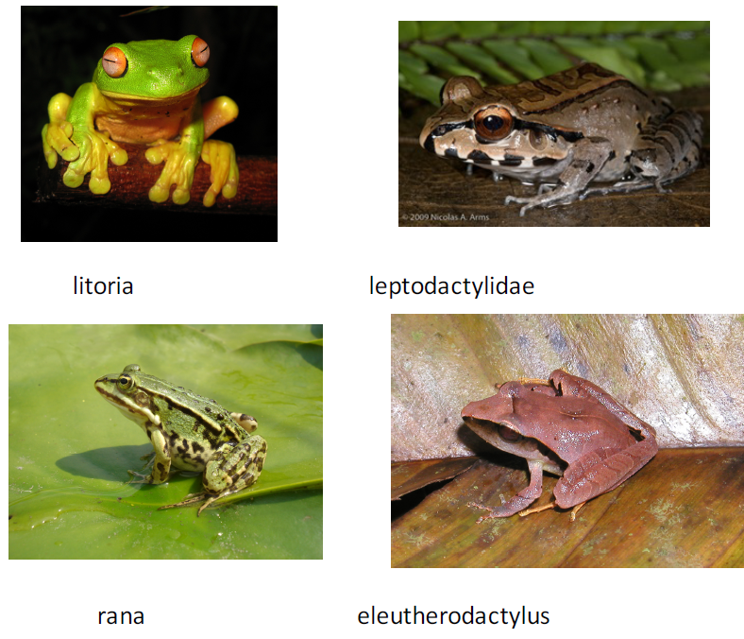
Glove results
Nearest words to
frog:
frogs
toad
litoria
leptodactylidae
rana
lizard
eleutherodactylus

Slide 45
What to do with the two sets of vectors?
We end up with U and V from all the vectors u and v (in columns)
Both capture similar co-occurrence information. It turns out, the best solution is to simply sum them up:
X_{final} = U + V
One of many hyperparameters explored in GloVe: Global Vectors for Word Representation (Pennington et al. (2014)

Slide 46
How to evaluate word vectors?
Related to general evaluation in NLP: Intrinsic vs extrinsic
Intrinsic:
Evaluation on a specific/intermediate subtask
Fast to compute
Helps to understand that system
Not clear if really helpful unless correlation to real task is established
• Extrinsic:
Evaluation on a real task
Can take a long time to compute accuracy
Unclear if the subsystem is the problem or its interaction or other subsystems
If replacing one subsystem with another improves accuracy → Winning!

Slide 47
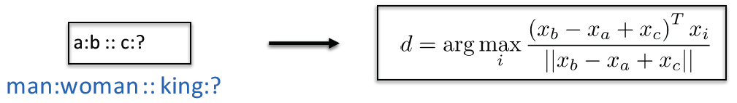
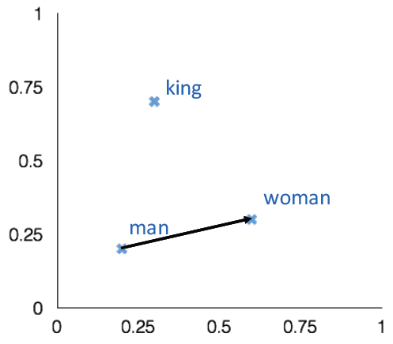
Intrinsic word vector evaluation
Word Vector Analogies
Evaluate word vectors by how well their cosine distance after addition captures intuitive semantic and syntactic analogy questions
Discarding the input words from the search!
Problem: What if the information is there but not linear?

Slide 48
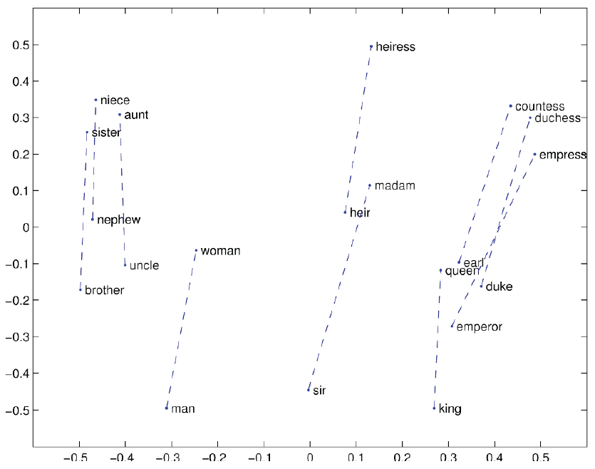
Glove Visualizations

Slide 49
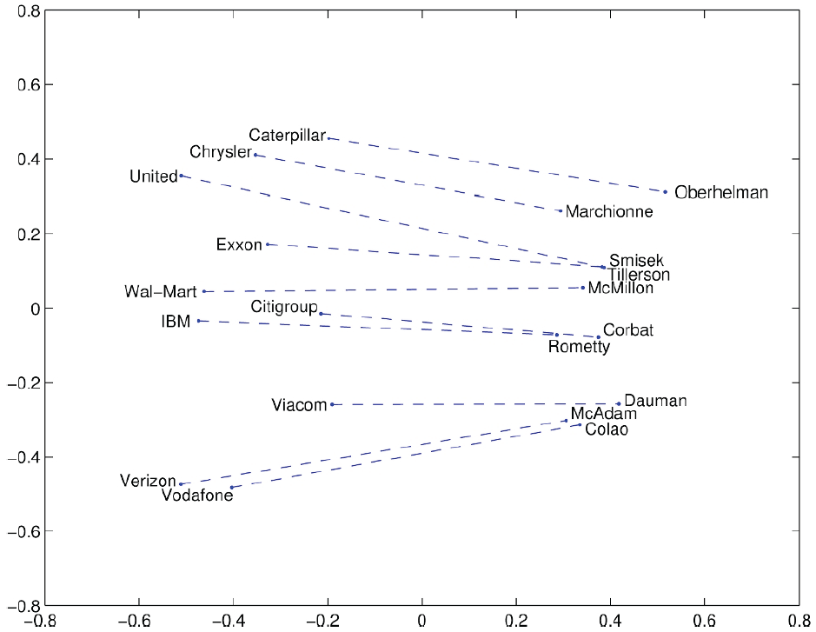
Glove Visualizations: Company - CEO

Slide 50
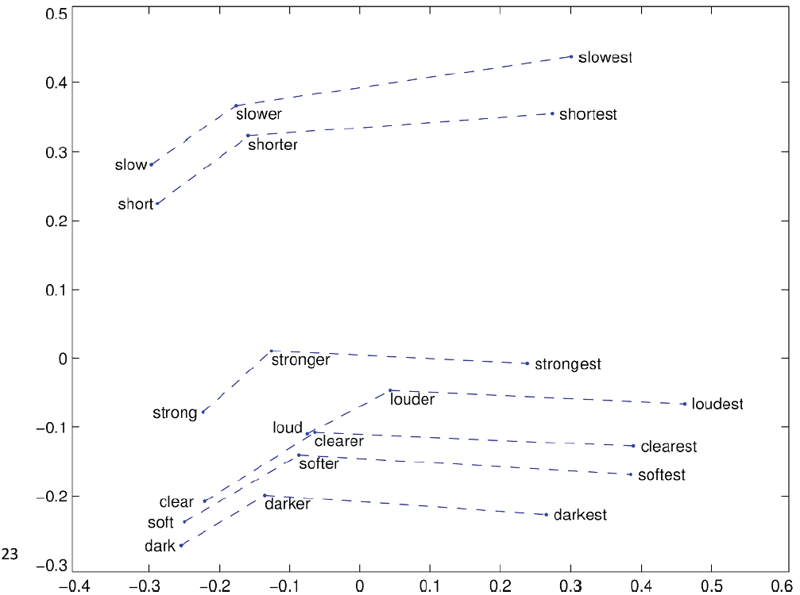
Glove Visualizations: Superlatives

Slide 51
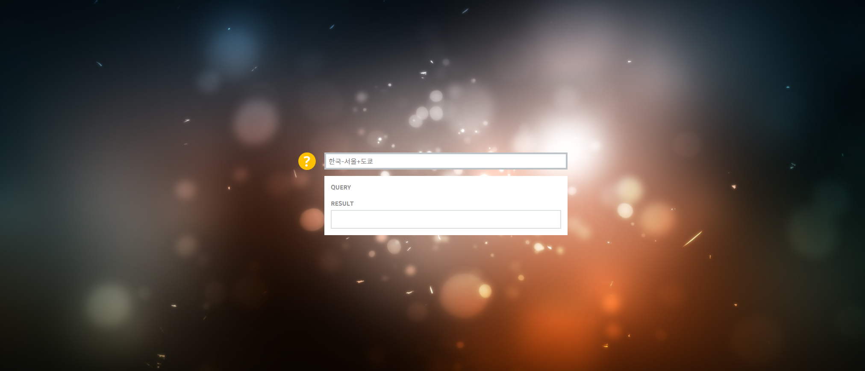
Analogy Reasoning Task
http://w.elnn.kr/search/

Slide 52
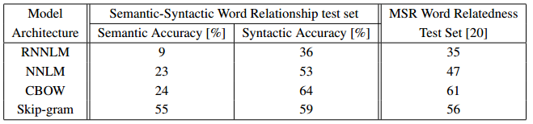
Analogy Reasoning Task
Analogy Reasoning Task Results for Various Models.
Word Dimension = 640

Slide 53
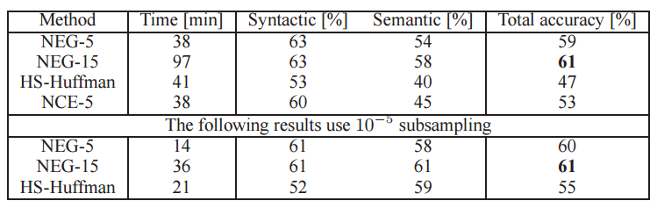
Analogy Reasoning Task
Analogy Reasoning Task Results for Various Models.
Word Dimension = 300

Slide 54
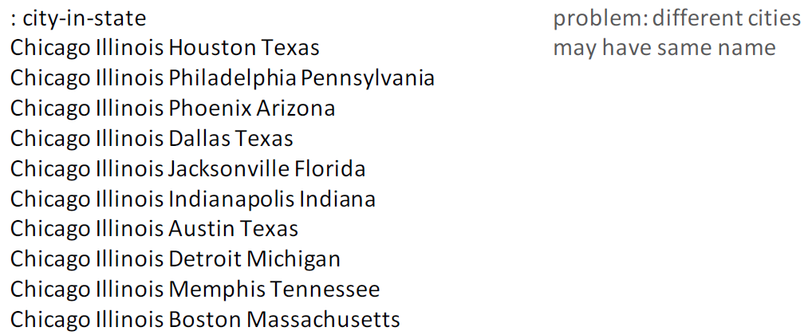
Details of intrinsic word vector evaluation
Word Vector Analogies: Syntactic and Semantic examples from http://code.google.com/p/word2vec/source/browse/trunk/questionswords.txt

Slide 55
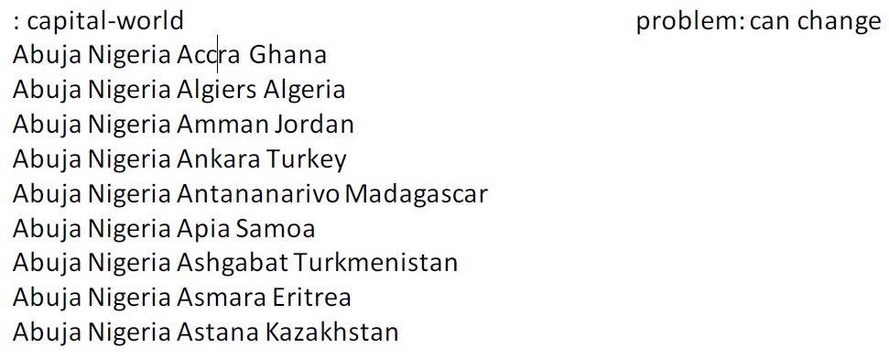
Details of intrinsic word vector evaluation
Word Vector Analogies: Syntactic and Semantic examples from

Slide 56
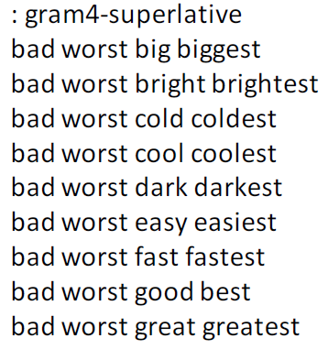
Details of intrinsic word vector evaluation
Word Vector Analogies: Syntactic and Semantic examples from

Slide 57
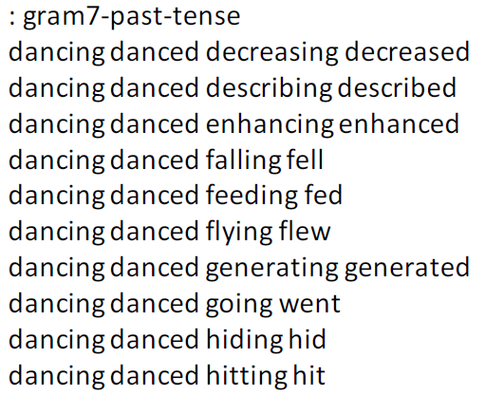
Details of intrinsic word vector evaluation
Word Vector Analogies: Syntactic and Semantic examples from

Slide 58
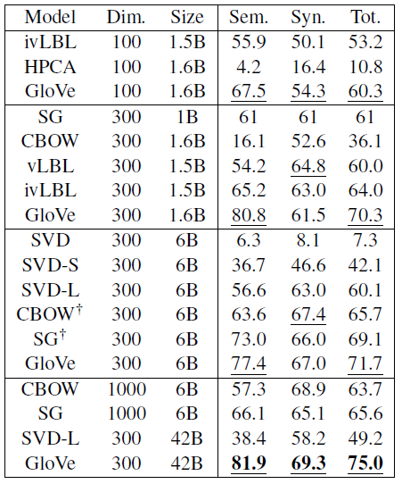
Analogy evaluation and hyperparameters
Very careful analysis: Glove word vectors

Slide 59
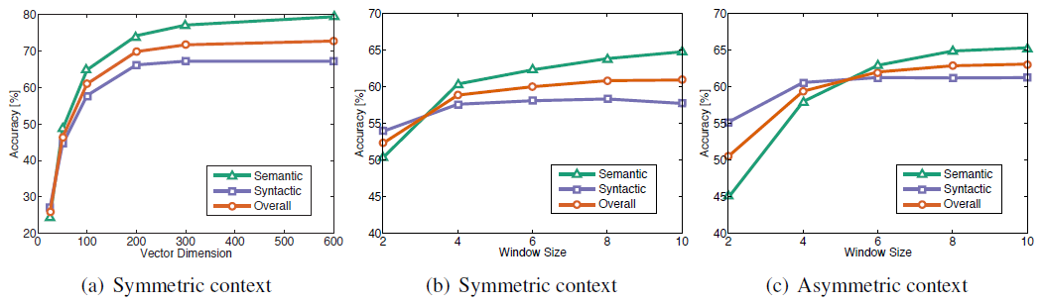
Analogy evaluation and hyperparameters
Asymmetric context (only words to the left) are not as good
Best dimensions ~300, slight drop-off afterwards
But this might be different for downstream tasks!
Window size of 8 around each center word is good for Glove vectors

Slide 60

Analogy evaluation and hyperparameters
More training time helps

Slide 61

Analogy evaluation and hyperparameters
More data helps, Wikipedia is better than news text!

Slide 62

How to evaluate word vectors?
Word vector distances and their correlation with human judgments
Example dataset: WordSim353 http://www.cs.technion.ac.il/~gabr/resources/data/wordsim353/

Slide 63

Correlation evaluation
Word vector distances and their correlation with human judgments
Some ideas from Glove paper have been shown to improve skip-gram (SG) model also (e.g. sum both vectors)

Slide 64
But what about ambiguity?
You may hope that one vector captures both kinds of information (run = verb and noun) but then vector is pulled in different directions
Alternative described in: Improving Word Representations Via Global Context And Multiple Word Prototypes (Huang et al. 2012)
Idea: Cluster word windows around words, retrain with each word assigned to multiple different clusters bank₁, bank₂, etc

Slide 65

But what about ambiguity?
Improving Word Representations Via Global Context And Multiple Word Prototypes (Huang et al. 2012)

Slide 66

Extrinsic word vector evaluation
Extrinsic evaluation of word vectors: All subsequent tasks in this class
One example where good word vectors should help directly: named entity recognition: finding a person, organization or location
Next: How to use word vectors in neural net models!

Slide 67
Simple single word classification
What is the major benefit of deep learned word vectors?
Ability to also classify words accurately
Countries cluster together → classifying location words should be possible with word vectors
Incorporate any information into them other tasks
Project sentiment into words to find most positive/negative words in corpus

Slide 68



The softmax
Logistic regression = Softmax classification on word vector x to obtain probability for class y:
where:
Generalizes >2 classes (for just binary sigmoid unit would suffice as in skip-gram)

Slide 69

The softmax - details
Terminology: Loss function = cost function = objective function
Loss for softmax: Cross entropy
To compute p(y|x): first take the y’th row of W and multiply that with row with x:
Compute all fc for c=1,…,C
Normalize to obtain probability with softmax function:

Slide 70
The softmax and cross-entropy error
The loss wants to maximize the probability of the correct class y
Hence, we minimize the negative log probability of that class:
As before: we sum up multiple cross entropy errors if we have multiple classifications in our total error function over the corpus (more next lecture)

Slide 71

Background: The Cross entropy error
Assuming a ground truth (or gold or target) probability distribution that is 1 at the right class and 0 everywhere else: p = [0,…,0,1,0,…0] and our computed probability is q, then the cross entropy is:
Because of one-hot p, the only term left is the negative probability of the true class
Cross-entropy can be re-written in terms of the entropy and Kullback-Leibler divergence between the two distributions:

Slide 72
The KL divergence
Cross entropy:
Because p is zero in our case (and even if it wasn’t it would be fixed and have no contribution to gradient), to minimize this is equal to minimizing the KL divergence
The KL divergence is not a distance but a non-symmetric measure of the difference between two probability distributions p and q

Slide 73
PSet 1
Derive the gradient of the cross entropy error with respect to the input word vector x and the matrix W

Slide 74
Simple single word classification
Example: Sentiment
Two options: train only softmax weights W and fix word vectors or also train word vectors
Question: What are the advantages and disadvantages of training the word vectors?
Pro: better fit on training data
Con: Worse generalization because the words move in the vector space

Slide 75

Visualization of sentiment trained word vectors

Slide 76
Next level up: Window classification
Single word classification has no context!
Let’s add context by taking in windows and classifying the center word of that window!
Possible: Softmax and cross entropy error or max-margin loss
Next class!

Slide 77
Q&A

